Slide 1
HOW TO HANDLE THE POST PH.D. BLUES
Disorientation, Depression, Relocation
ساعة معرفة
الثلاثاء3/2/2019
غادة الهدهود
قسم تقنية المعلومات
كلية علوم الحاسب و المعلومات

Slide 2
Agenda
Summary of PhD Journey
The Blues Knockout
Pre-PhD Award: Be Ready
Post PhD Award: Emotionally Alone, Disorder, Depression
Post-dissertation life
Be the change you want to see
PhD and Academia for Female Surviving the Process & Recommendations

Slide 3
Summary of PhD Journey
Working independently,
Sticking to self-imposed deadlines Focusing on the big picture
Studying best writing practices,
Committed a strict schedule,
Participated in workshops
Task oriented so we have no trouble staying on task and self-motivating.
Finally, Congratulations Doctor

Slide 4
The Blues Knockout
Post PhD Emotionally Alone, Disorder, Depression
The day right after being awarded PhD; What is going on? Is it real? Emotionally scattered
A month after being awarded the PhD; feeling lack of productivity after finishing Ph.D; Depression
Few months after being back home; am I alone feeling, disoriented?

Slide 5
There Has Been No Phase of Reintegration
You describe a feeling that people have been experiencing for decades, and as an anthropologist you might recognize the effects of a kind of failure of ritual passage. We usually mark such transitions with rituals that clearly remove us from the old status and propel us into the new status, in this case "Doctor" Rodwell, etc. The dissertation defense is a good example of the symbolic killing and resurrection that accompanies many rites of passage, but for many years in American graduate programs there has been no phase of reintegration, no emergence from the seclusion hut or getting pelted with rice to mark the new status, and we're left feeling incomplete. European models are a little better at ritualizing this passage, and we might look to them for ideas..... In the meantime, essays such as yours can help remind others that we've all been there, and you get over it soon.... Cordially, Barbara

Slide 6
Withdraw Syndrome and Self-reaction
I wandered aimlessly around the house for about a week. There is definitely a withdrawl syndrome. Mum told me to go back to uni and get some writing done.

Slide 7
Learned To Enjoy Doing Other Things
A frew days later I did go through a sort of existential depression. What really hit me was that I really did not accomplish anything. People would congratulate me and I would just brush it off as if what I accomplished was really not that big of a deal. I get now why so few people finish their disseration even after completing all thier course work and thier comprehensive exams. It is scary thought. I have been in school so long and now what? What helped me through the transition was my teaching . I found this to be therapuetic. I find that I still challenge myself, but learned to enjoy doing other things.

Slide 8
Share Your Experience: Write Things That Is Taught
This is a good article that should be posted on many other academic websites. It is a very relatable experience for many of us who finished our Ph.Ds. The discipline of daily putting one's behind in a chair to write for two or three hours is gone. I struggle with that, as do many other people I know. It is hard to corral the motivation to continue doing what we were trained to do. Post-Ph.D., most people continue to write because they are trying to get tenure or increase their rank. Rarely do they write out of the pure pleasure of doing it. Sitting down and writing is hard work, especially for those of us who are not natural writers. I do it because I feel that I can still make a useful contribution to my field. But I will admit, having the motivation and dedication to sitting down and writing every evening is tough. https://chroniclevitae.com/news/1046-surviving-the-post-dissertation-slump

Slide 9
Decide To Plan What Is Next
I can identify with the "impostor syndrome" and feeling like the defense was easier than it should have been. I'm glad I didn't have any substantial revisions, but now what?

Slide 10
Find Your Love And Pursue It With All The Passion In Your Heart
I explored options to teach, but would have to move far away from Florida, my home. I talked with former Professors and administrators. I am now a full-time Writer, but this isn't exactly what I thought I would be doing. So, all I am saying is this, if you don't find a position in school you wish to teach at, please be flexible. Teaching jobs are tough to find. Yet, everything is so competitive. Find your love and pursue it with all the passion in your heart. Destiny has a way of guiding our lives to the eventual, best ends for everyone, even though at the time, we may not be able to grasp the big picture completely.

Slide 11
Repurpose Your Life
Thanks so much for this article. Very timely, even though I completed my dissertation over ten years ago. My second book is just going to press and that feeling of disorientation is very real, familiar and difficulty to deal with. Perhaps it just helps to know that I'm not the only one going through this. It really is an occasion to recall and repurpose your life.

Slide 12
PhD loneliness
will hit you when you are working at midnight on some research topic nobody in your continent understands (or give a damn about) except for you.
You are in a scientific micro-niche. So micro, you got nobody to talk with. And you feel alone.
After all, you are born alone. You do a PhD alone. You die alone.
It’s true that a PhD means doing independent research. YOU need to figure things out.

Slide 13
Pre-Phd Award: Be Ready
Become involved in your institute club or honor society if one exists.
Participate in National and regional conferences
Allow others to get in contact with you
Attend events and seminars

Slide 14
You are alone emotionally, Research Oriented, Depressed
If you cannot bitch openly about doing a research to continue your PhD work.
This might not be the case for you.
You might be the only micro niche-PhD in your department.
Or your fellow PhDs might be too self-centred.
It’s common to feel like you have nobody to complain to.
Bear with me, you can change this, I will show you how.

Slide 15
Post-PhD Life I
It’s true that a PhD means doing independent research
Working at midnight on some research topic nobody in your continent understands except for you.
You are in a scientific micro-niche
Do not panic, feel free to relax a bit
A myth: ‘ If you are task oriented; the adjustment takes time.’

Slide 16
Post-PhD Life II
You shouldn’t keep those negative feelings about your loneliness inside.
Let them out. Share them with somebody in your same shoes.
Show your positive side to people.
People will want to spend time with you and you will feel less alone.
Be excited about other people’s research. Challenge them. Ask them questions. Check now and then how their research is progressing.

Slide 17
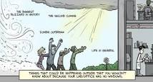
Be the change you want to see
If you want deep conversations … start one.
If you want to be listened … listen to others first.
If you want to be helped … help other colleagues that might feel alone.
If you want feedback … give constructive feedback.

Slide 18
PhD Holder and Academia
Once you’re in the system, the system keeps you there by refusing to prepare you for anything else, including an industry job.
We have a belief that nothing else but staying in academia is respected.
Hence you can’t do anything except staying in academia.

Slide 19
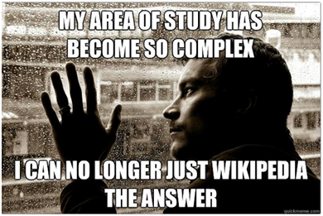
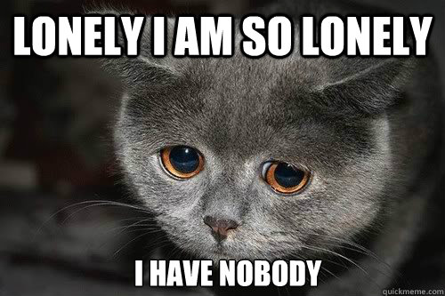
Turn PhD loneliness around
Feel connected and surrounded by great people
How; Is the solution to PhD loneliness to do a PhD
in a research group with lots of other scientists?

Slide 20
Surviving the Process Recommendations I: PERSONALITY
Avoid competition and departmental opposition
Make an active effort to reach out to others and collaborate.
Put your head down and do your work: No matter how smart you may be, how great a teacher, or researcher, you will need the help of others in your research.
You need a mentor professor who is familiar with your area of research who can direct you when needed and have resources and connections
Mentor professors have access to more grant money, equipment, and connections, while non-tenured professors are more personally available for assistance and advice.

Slide 21
Surviving the Process Recommendations I: JOIN A GROUP
Choose people who you can work with, and who share a common research interest
Make an active effort to reach out to others and collaborate.

Slide 22
Surviving the Process Recommendations II: BALANCE
Balance teaching responsibilities with research and coursework
Make sure you've developed a healthy balance between all your responsibilities.
If you've never taught before, it can be difficult to find the time to spend on completing the research you want to complete, when you've got a stack of fifty papers to grade, lesson plans to prepare, and a student in tears at your office door.
Don't Try to do everything at once.
Stay organized. Despite the reputation of academics as absent-minded Professors, getting a PhD takes an ordered mind.
Learn to prioritize tasks and relegate less-critical chores until later. Do one thing at a time. Break large jobs down into smaller manageable tasks that you can complete and move on.
Recommendation:
Create opportunities for yourself and work around the challenges.

Slide 23
Surviving the Process Recommendations III: DISPLAY INITIATIVES
You'll face a variety of challenges: missing information about grant money, your paper may get rejected from a conference.
Become involved in your academic department's club or honor society if one exists.
If not, speak with your advisor or department chair about starting one.
National and regional conferences allow the opportunity to get contacts with experts

Slide 24
Surviving the Process Recommendations IV: STAY CONNECTED
Initiate connections with a research group with lots of other scientists who are experts in your field.
Networking is for scientists Having a solid network of contacts in from conferences
Feel connected and surrounded by great people: Scientific OR Social??
Becoming social and connecting with people takes time and more importantly, your effort. It is uncomfortable and scary, I admit it.

Slide 25
References
https://chroniclevitae.com/news/1046-surviving-the-post-dissertation-slump

Slide 26
Thank you
Any Questions??????
Ghada AL-Hudhud
galhudhud@ksu.edu.sa

